Slide 1

Capstone Design Team #14
Healthcare Telepresence Robot
Literature Survey
Team Members
Fernando Boaro
Chongdan Pan
Niyiqiu Liu
Ruixing Zhou
Tianyu Qiu

Slide 2
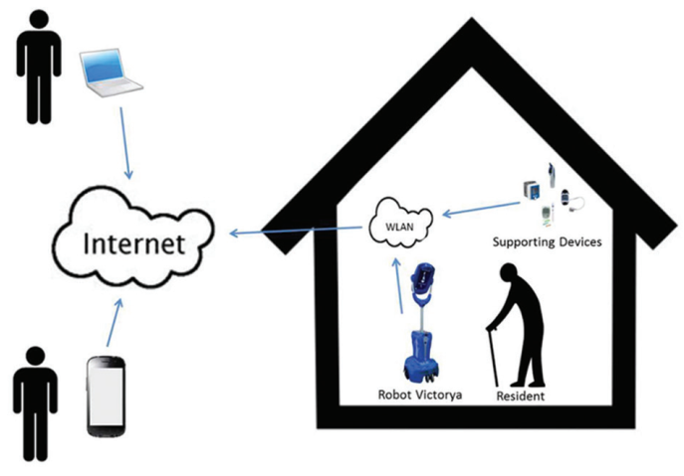
Latest Achievements
New Mobile Communication Method
Integrated Video-mediated Communication Tools
Remote Control of the Robotic System’s Movement
Smart Sensors
In-home Navigation Abilities

Slide 3
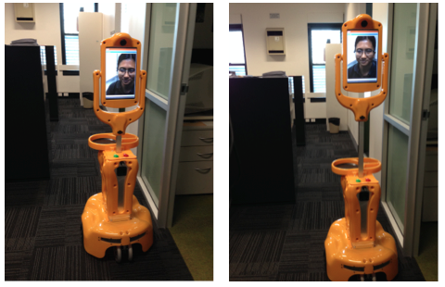
Newest Product: Giraffe Robot
Attributes:
Smart Medication Dispenser
Fall Detector
Android-based App for Remote Monitoring
Screen Lifting

Slide 4
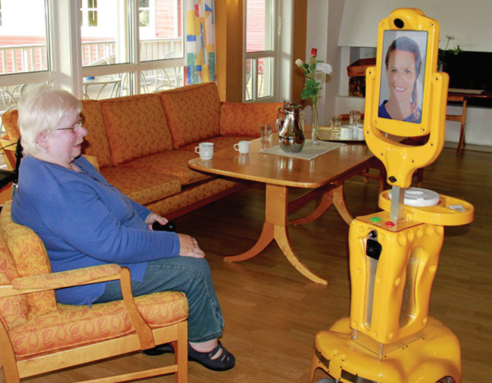
Newest Product: Giraffe Robot
Advantages:
Increasing feeling of happiness, sense of safety
Providing emotional connection between caregivers and old people.
Fall detection & Medication Dispenser
Disadvantages:
High cost, more than $5000
Fall detector malfunction
Firewall issues due to complex network structures
Drive Hardness due to video frame drop
Drive lag due to poor network.

Slide 5
Typical Development Method
Key Point: Building Connection
Connecting Devices
Arduino
Raspberry
Internal Network Connection
Low Cost
Easy Setup
Range Limitation
External Network Connection
Server Needed
Connection to World Wide Web
Global Coverage
Function Realization
Video Connection
Camera
Speaker
Microphone
Physical Connection
Motor-controlled Arm
Various Sensors

Slide 6
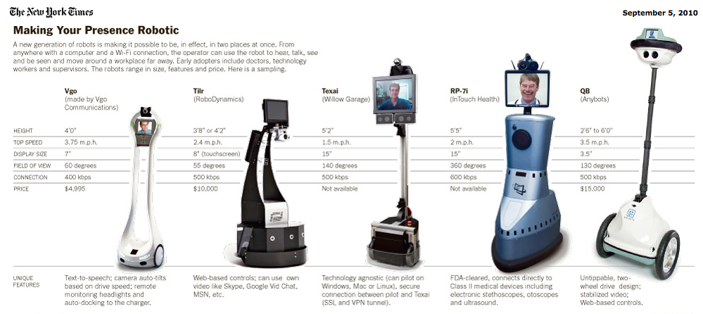
Future for Development
More Applications:
Remote medical treatment
Exploration to dangerous area
Remote supervision
Less Expense:
Function Simplification
Connection Stability Improvement

Slide 7
References
G. Zhang, J. P. Hansen, K. Minakata, A. Alapetite and Z. Wang, "Eye-Gaze-Controlled Telepresence Robots for People with Motor Disabilities," 2019 14th ACM/IEEE International Conference on Human-Robot Interaction (HRI), Daegu, Korea (South), 2019, pp. 574-575.
P. W. Ching, W. C. Yue and G. S. G. Lee, "Design and development of edgar - a telepresence humanoid for robot-mediated communication and social applications," 2016 IEEE International Conference on Control and Robotics Engineering (ICCRE), Singapore, 2016, pp. 1-4.
Donald Kerr, J Artur Serrano, Pradeep Ray, “ The role of a disruptive digital technology for home‑based healthcare of the elderly: Telepresence robot ," Digital Medicine, Year 2018, Volume 4, Issue 4 [p. 173-179]
Key Word: Telepresence Robot
Search engine: Digital Medicine, IEEE/IET Electronic Library

